Slide 1
MemComb Sprint 2
Bassam Thomas
Danny Naum
Chris Stidham
Scott O’Neil
Nathan Hyde
David Michon
Jacob Couveau
Notes:
David

Slide 2
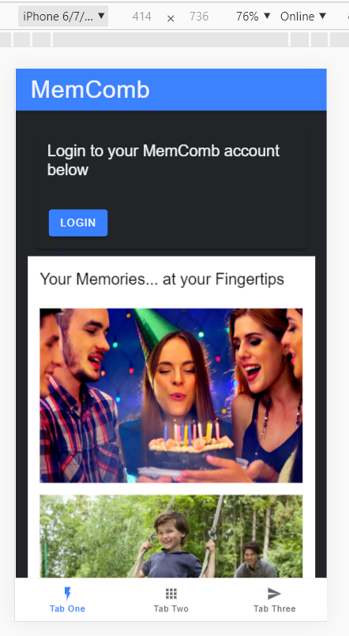
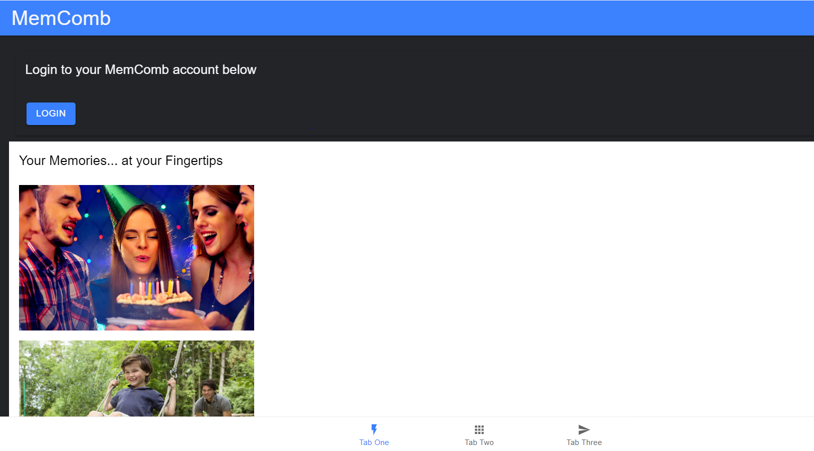
Landing Page UI
Notes:
Jacob

Slide 3
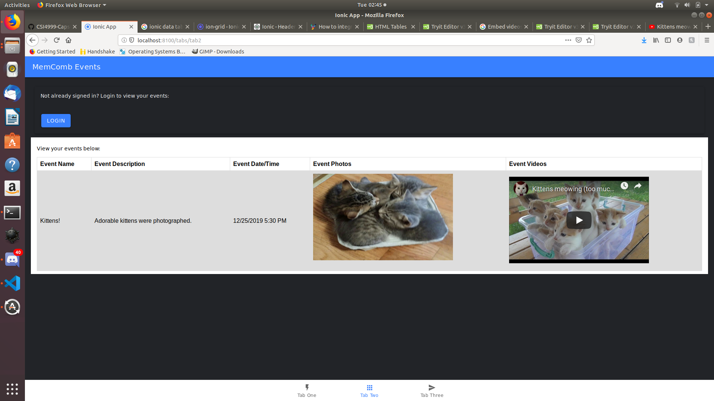
Events Page UI
Notes:
Nathan

Slide 4
Risks and Challenges
Integrating the database
Keeping the app from throwing errors when trying to run it on different machines
Making the app scalable for the desktop and app versions
Implementing the events that will store the audio/video/text files
Connecting different users based on similar stored items

Slide 5
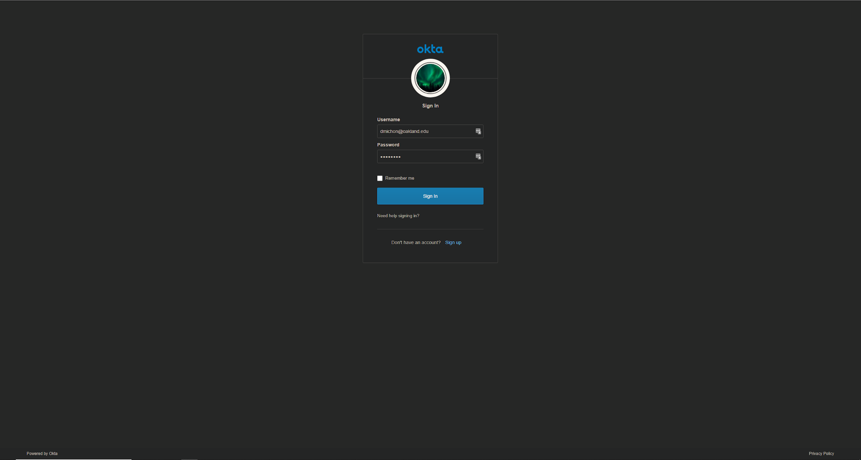
Login Page UI
Unable to change login page UI unless paid to host custom URL and domain

Slide 6
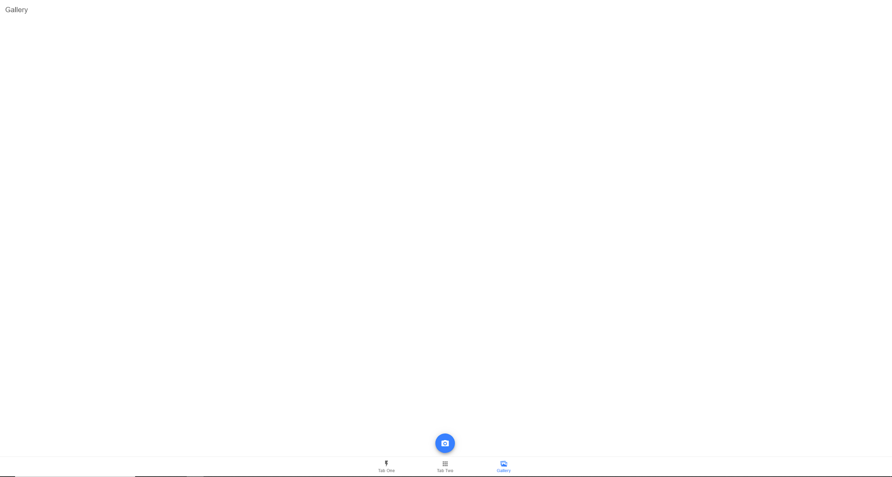
Camera Integration (Desktop)
Notes:
David

Slide 7
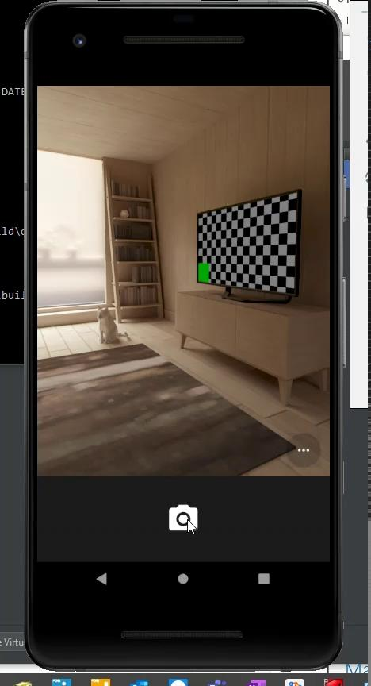
Camera Integration (Android)

Slide 8
Looking Forward
Next Sprints goals:
Full camera integration
As a user, I can use a physical Android phone to take pictures
As a user, I can see a gallery of the photos taken
Events Database
Creation of Database
Linking to Okta sign-in ID
Finish UI for Account Details
Notes:
David

